Slide 1
Alarm Clock
Here is where your presentation begins

Slide 2
Components required:
1
Arduino UNO-R3
5
LCD display
Push Buttons
6
2
Buzzer
3
Slide-swith
7
Resistor
4
Potentiometer
8
Connecting Wires

Slide 3
Arduino
Arduino is an open source platform. It reads the input and produces outputs as per the inserted codes.

Slide 4
LCD display
Liquid Crystal Display, a flat panel display that uses backlight or reflector to produce the images.

Slide 5
Potentiometer
A three-terminal resistor with a sliding or rotating contact that forms an adjustable voltage driver.

Slide 6
Resistor
Resistors are two-terminal electrical components for providing electrical resistance in the circuit.

Slide 7
Pizeo Buzzer
Device to generate basic alerting beeps and tones based on the condition specified.

Slide 8
Connecting wires
These are used as a connection medium for different components with the respective platforms.

Slide 9
Push Button
A simple button with a switch mechanism to impose controls

Slide 10
Slide Switch
A mechanical device with a slider on top of a switch

Slide 11

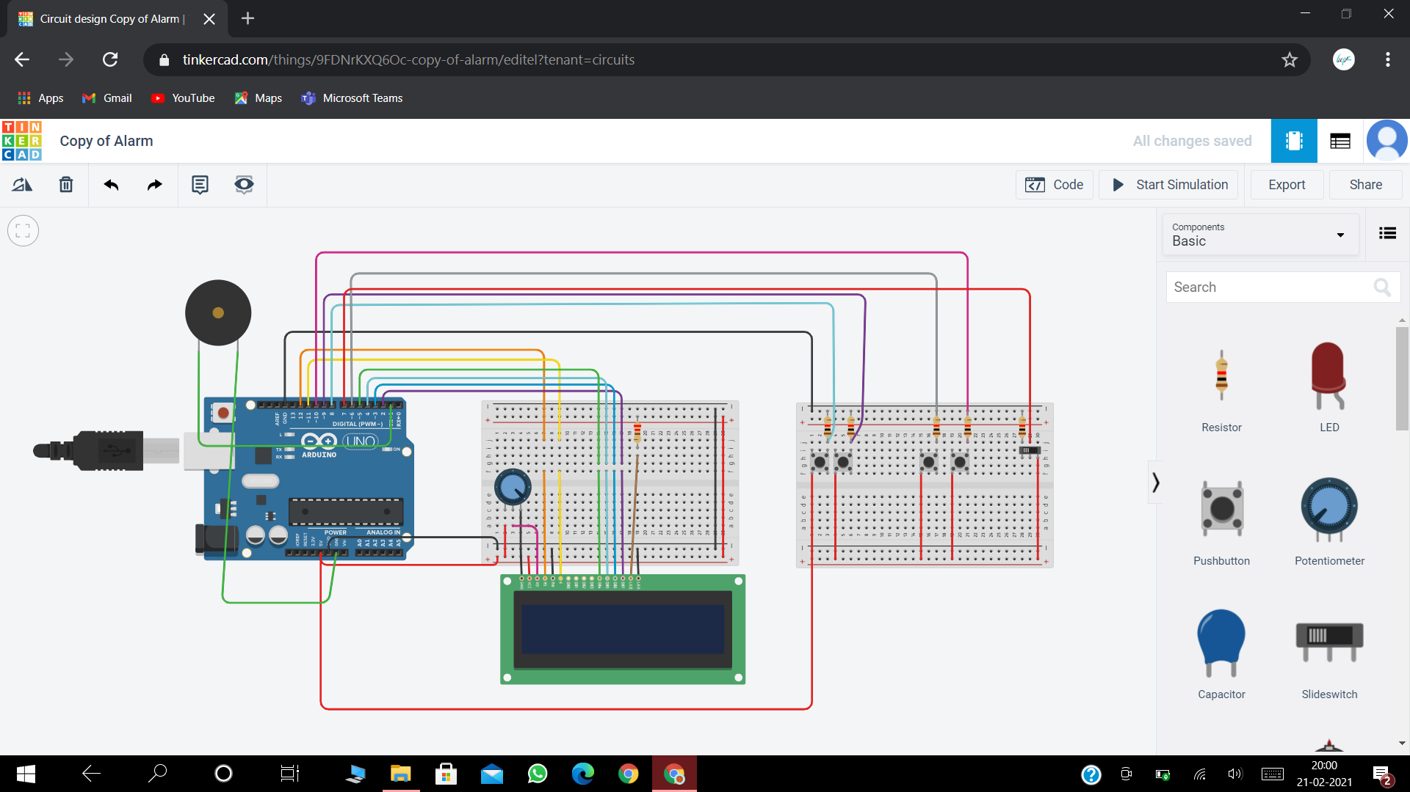
Circuit diagram

Slide 12
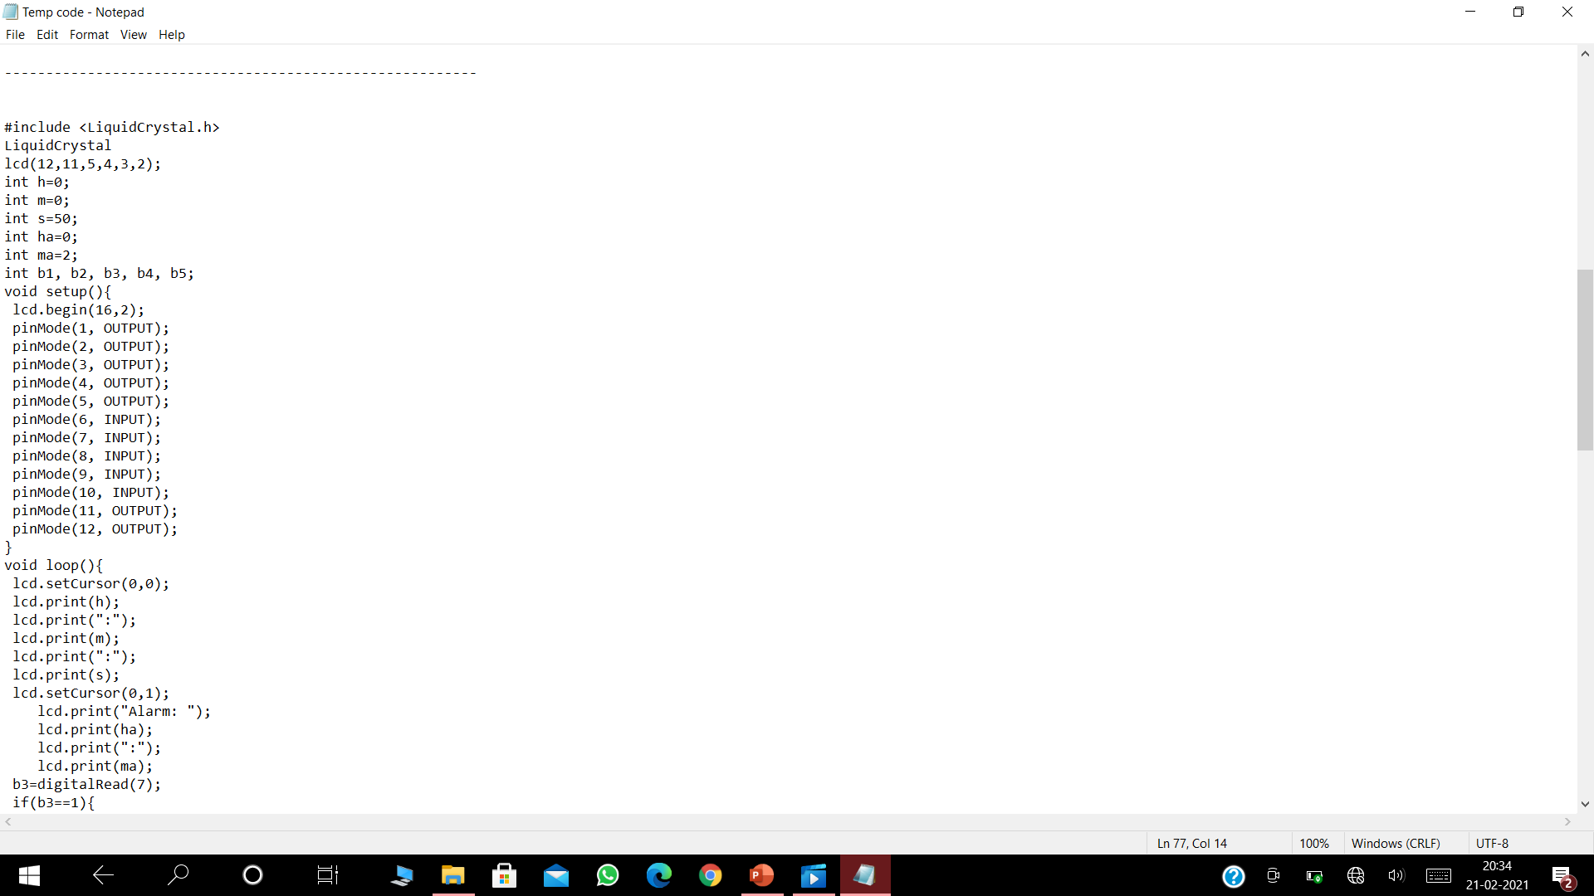
Code

Slide 13
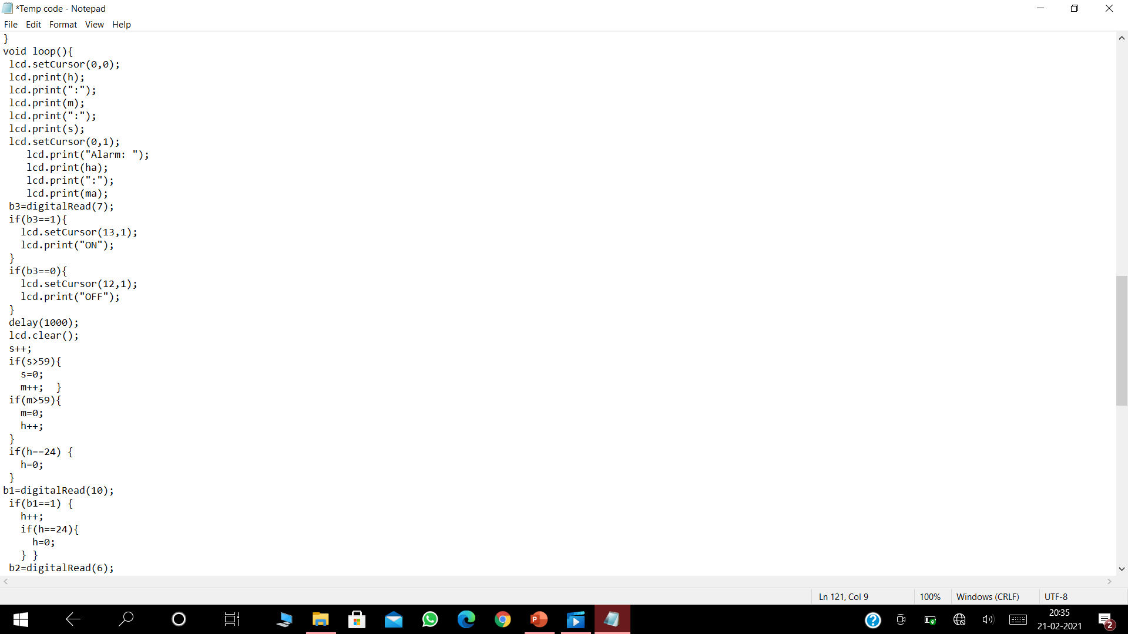
Code

Slide 14
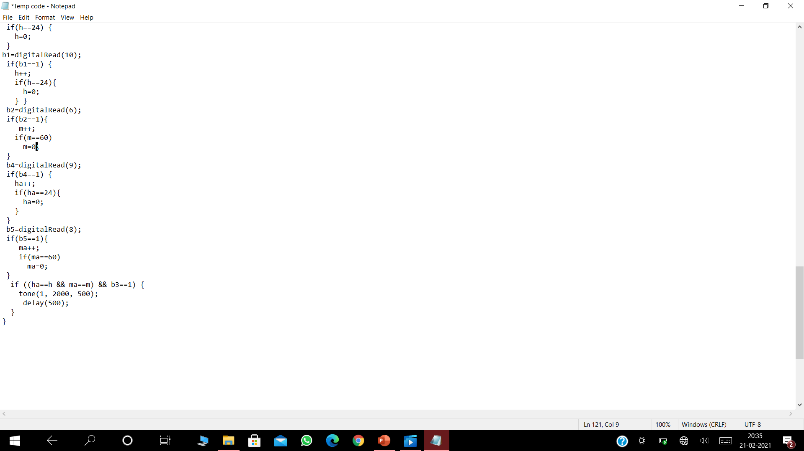
Code

Slide 15
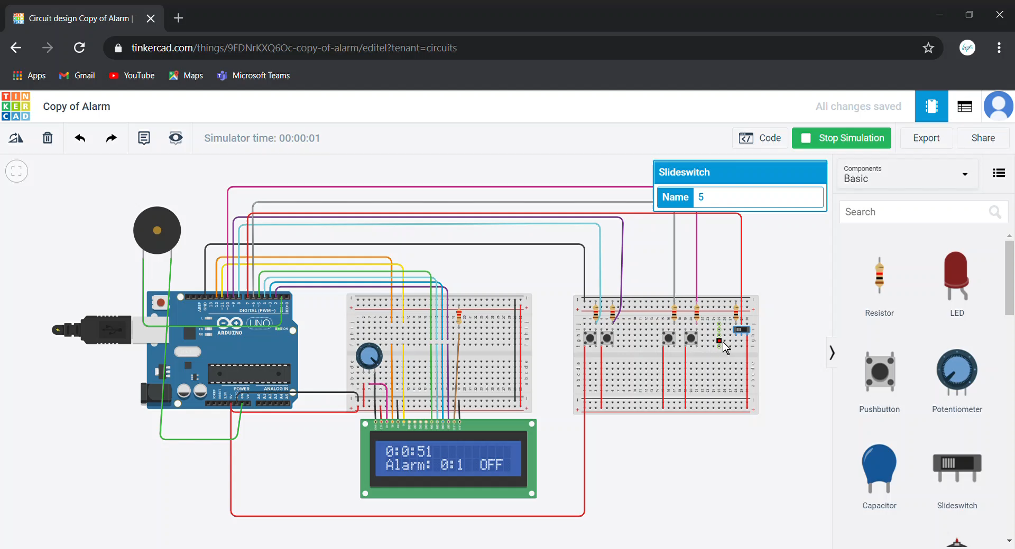
Demo

Slide 16
Happy learning!

